Slide 1

Leisure consumer survey findings
November 2023

Slide 2

About the study
The 2022 study provided a set of benchmarks, this was an opportunity to update and refresh those findings
Fieldwork took place in October 2023
In total 1,638 consumers completed the survey
To qualify for taking the survey respondents had to:
  live in Scotland (excluding Aberdeen and Aberdeenshire), the North of England, Midlands, South East England or London
  Be aged between 18 and 79
  Be open to, or haven taken, a domestic holiday in Great Britain during the past year
To limit survey length the sample was split, with a respondent only answering ’words and phrases’ questions about Aberdeen and a competitor city, or Aberdeenshire and a competitor rural destination

Slide 3
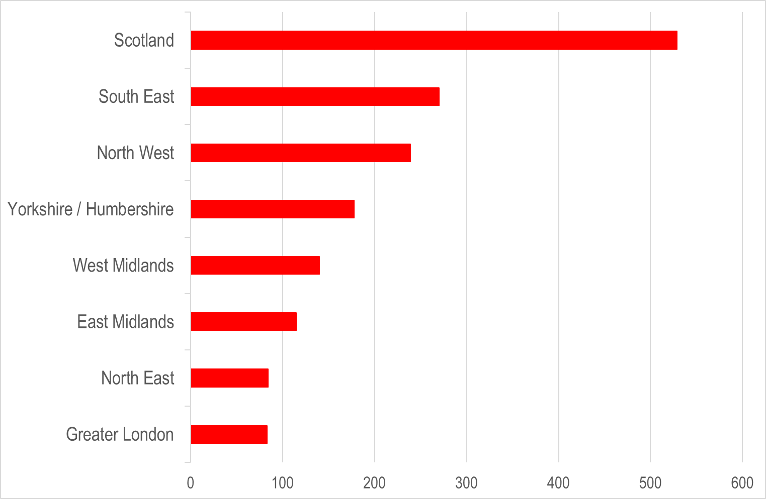
Respondent profile: where resident

Slide 4
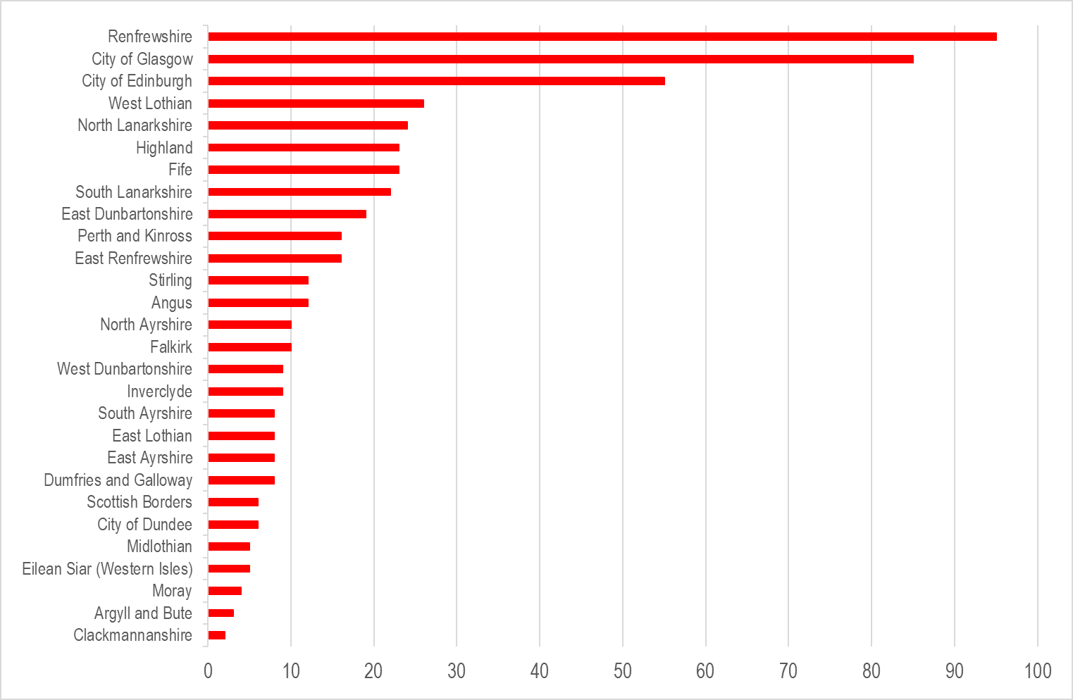
Respondent profile: where in Scotland

Slide 5
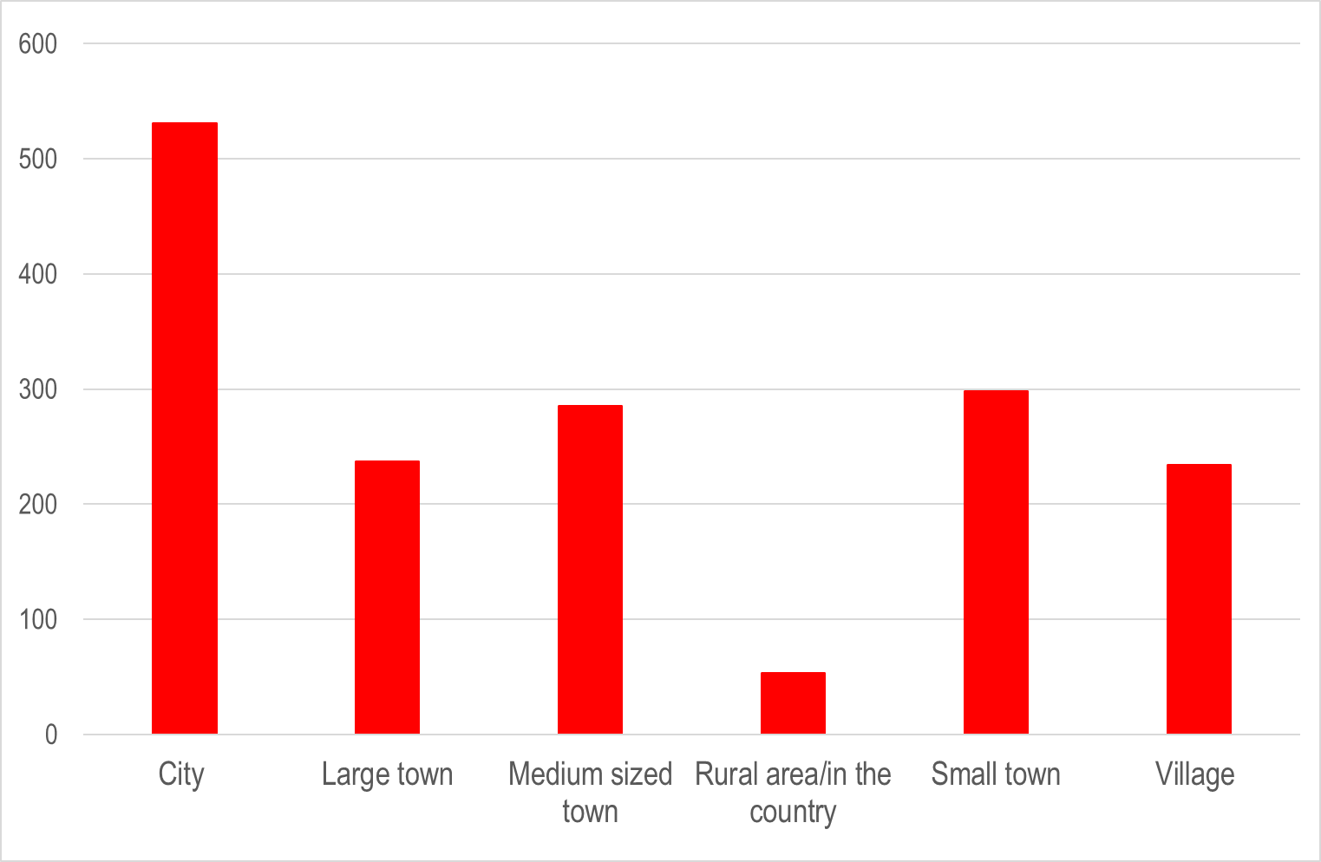
Respondent profile: type of place

Slide 6
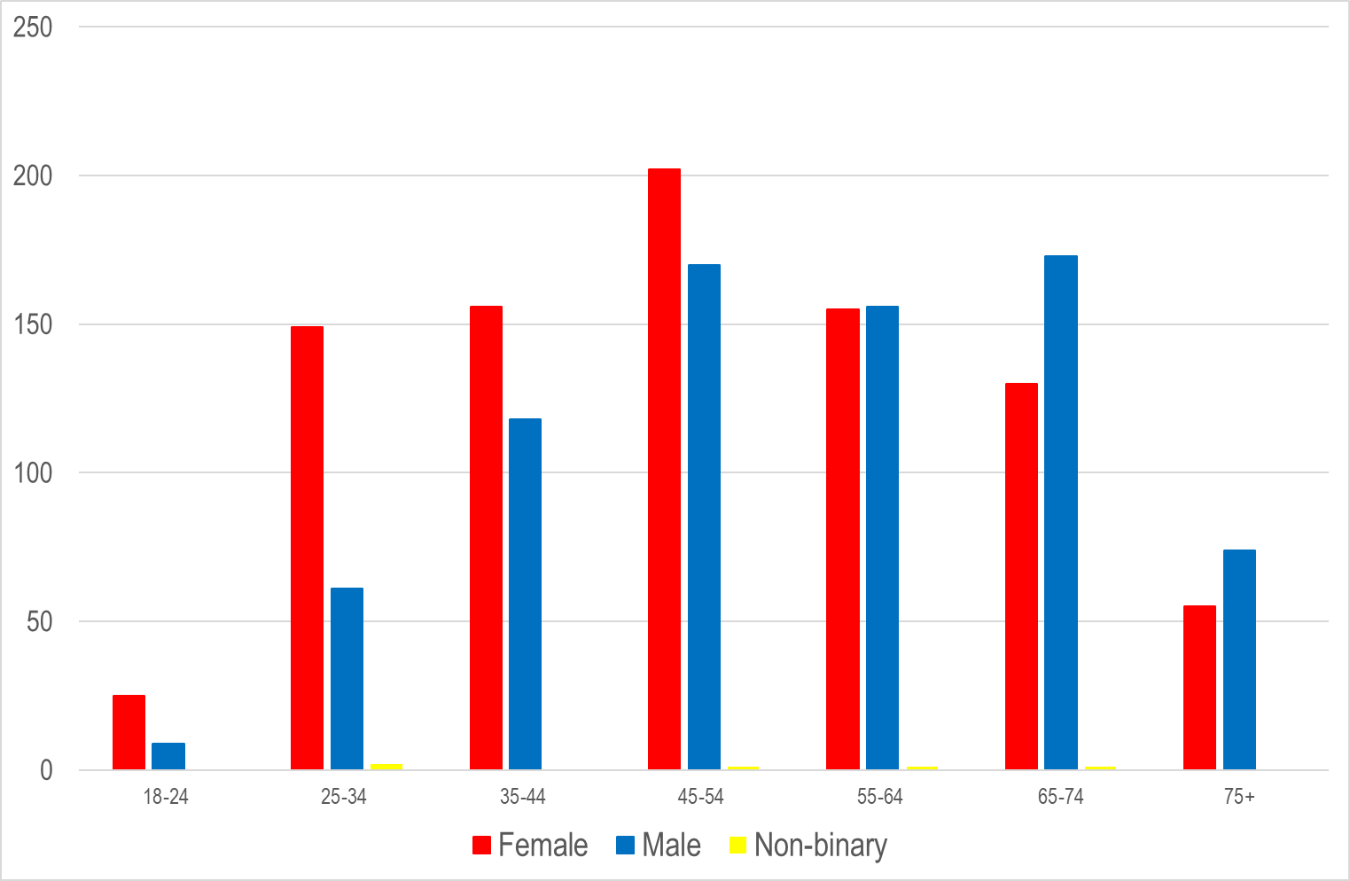
Respondent profile: demographics
53% female
47% male

Slide 7
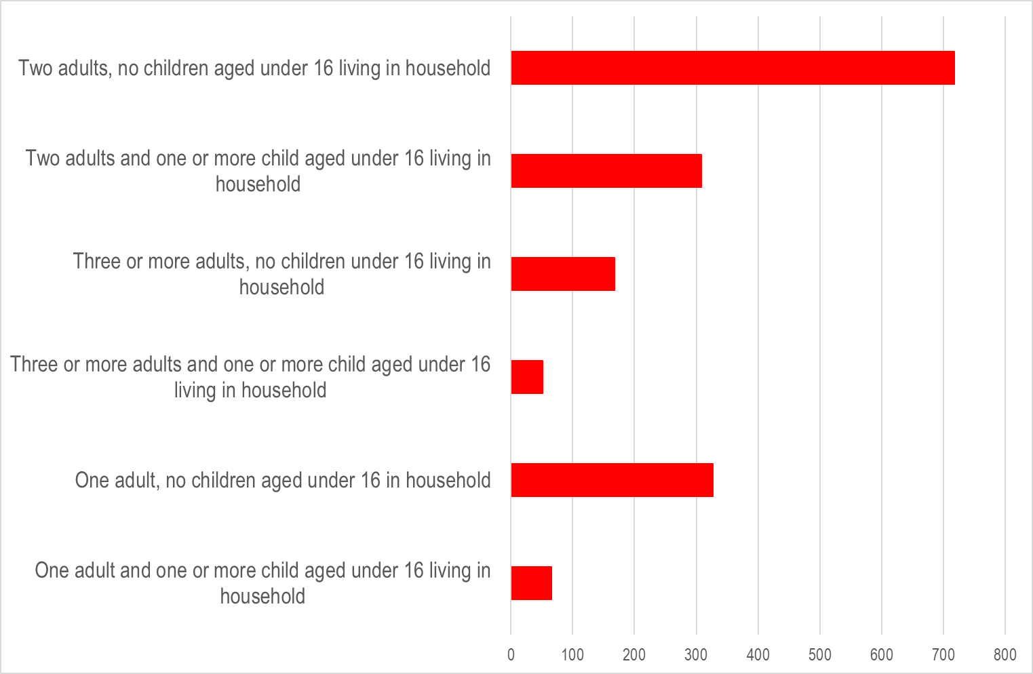
Respondent profile: household composition

Slide 8
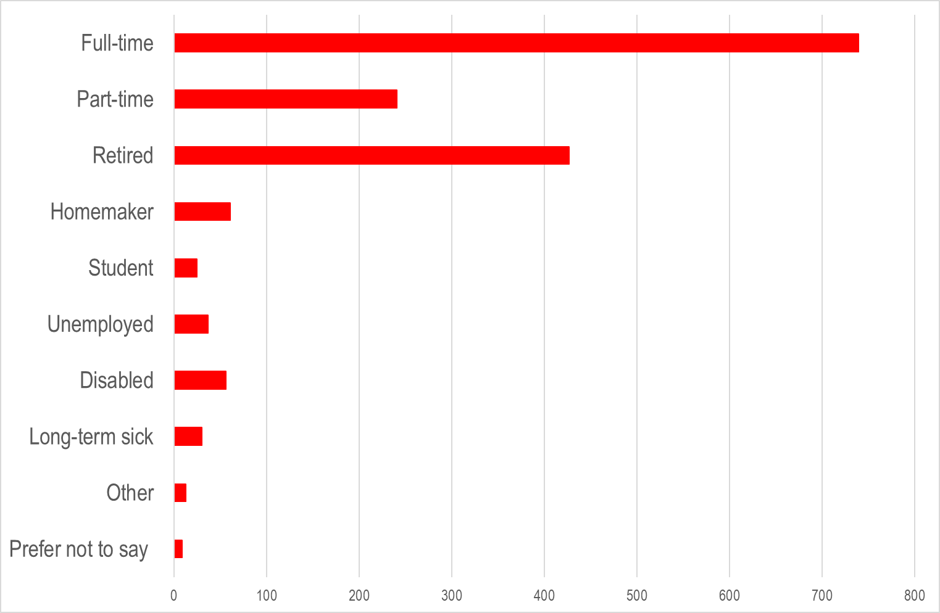
Respondent profile: employment status

Slide 9
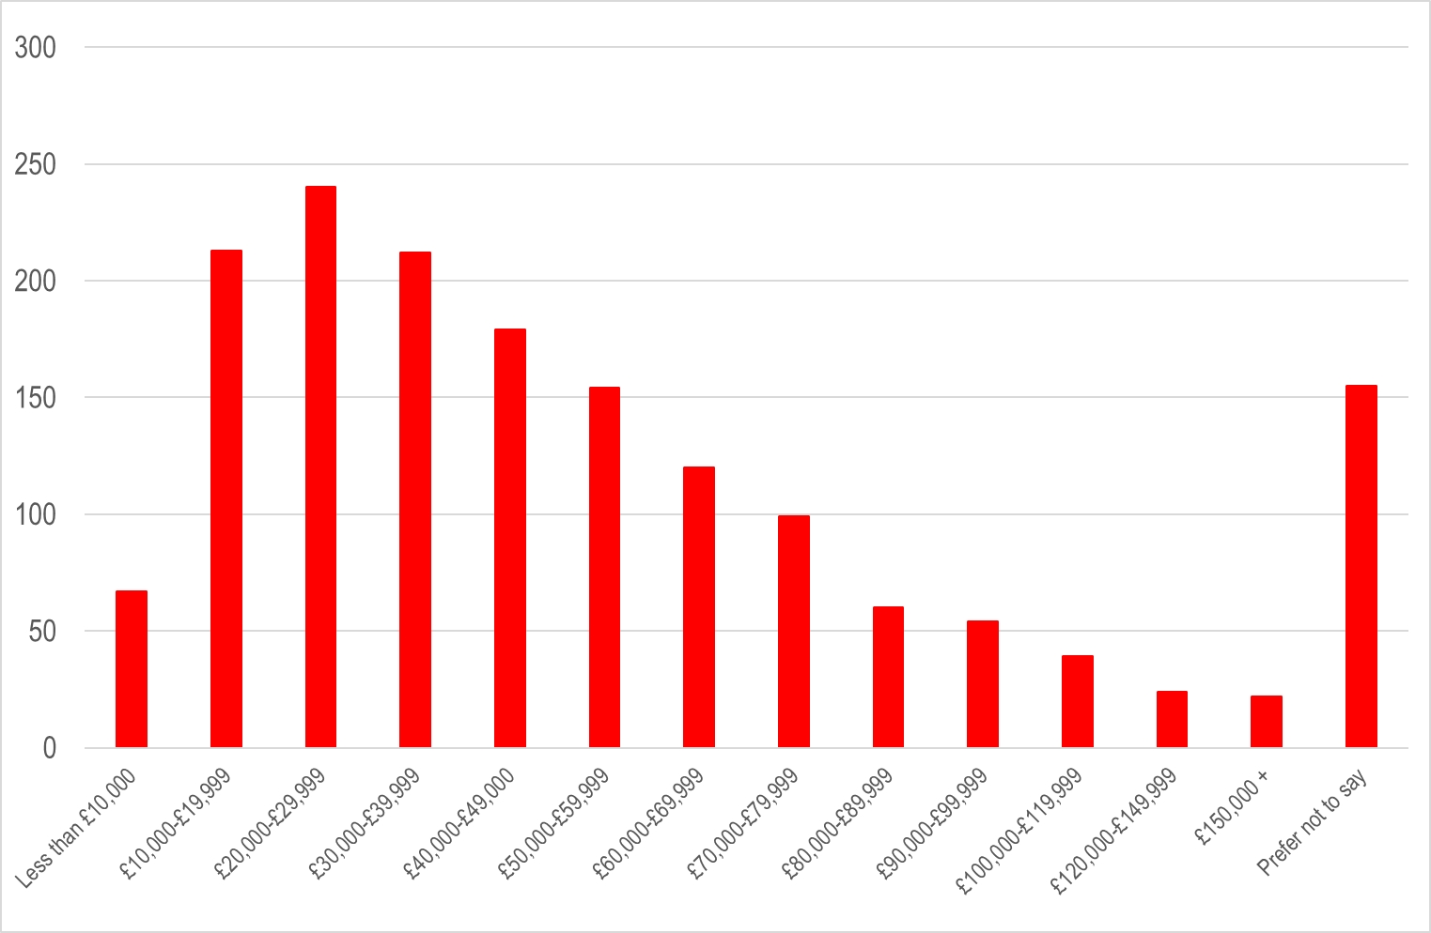
Respondent profile: annual household income

Slide 10
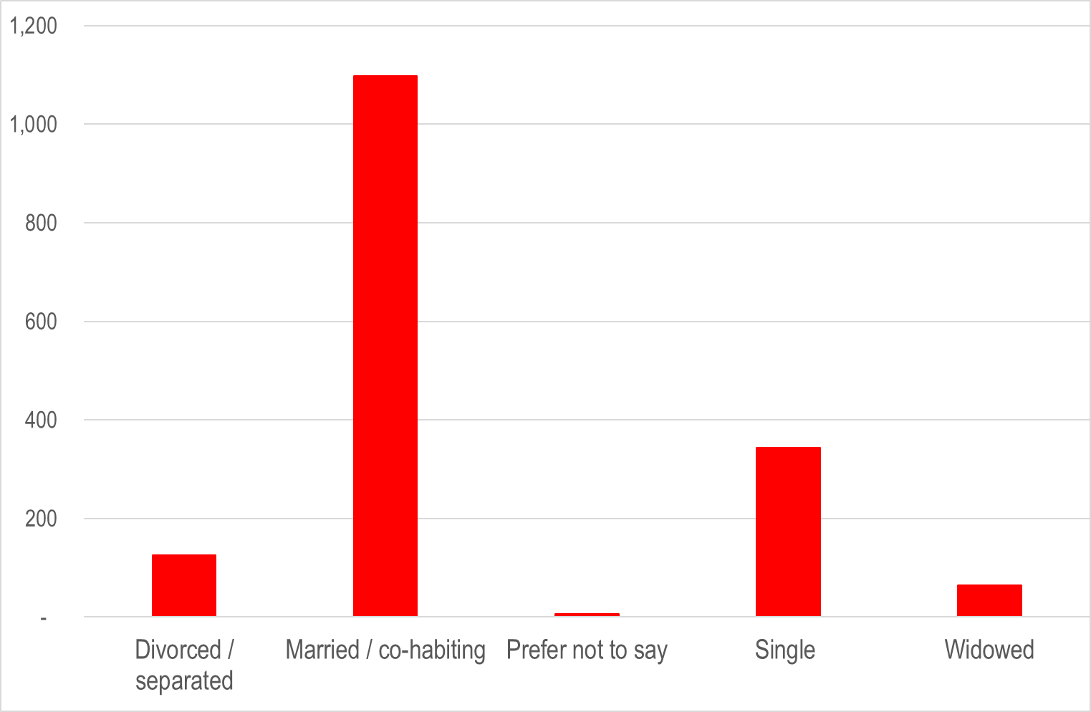
Respondent profile: marital status

Slide 11
Preference for different types of holiday

Slide 12
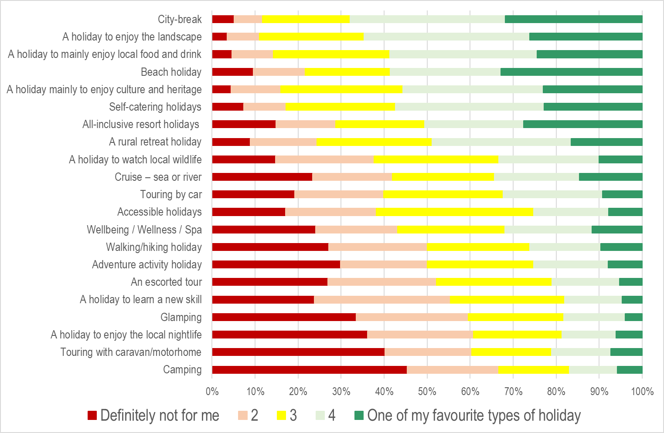
Preference for different types of holiday

Slide 13
Undertaking holiday activities

Slide 14
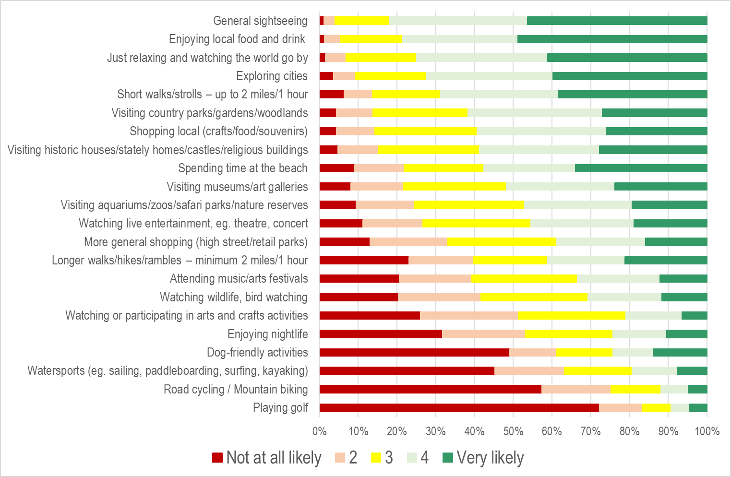
Undertaking holiday activities

Slide 15
Information sources used to decide where to go

Slide 16
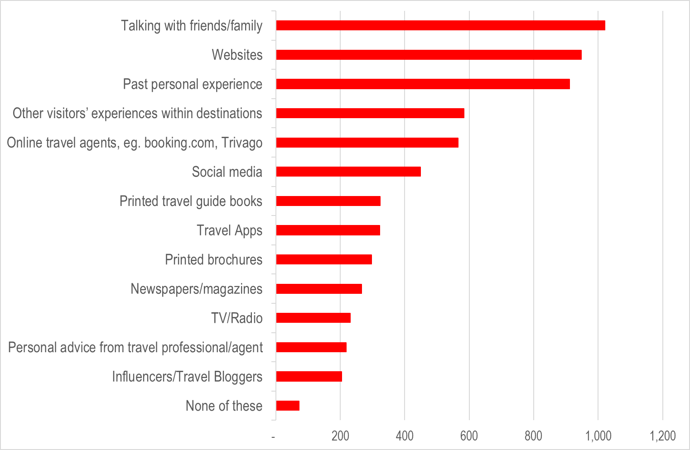
Information sources used to decide where to go

Slide 17
Types of website used when planning a holiday

Slide 18
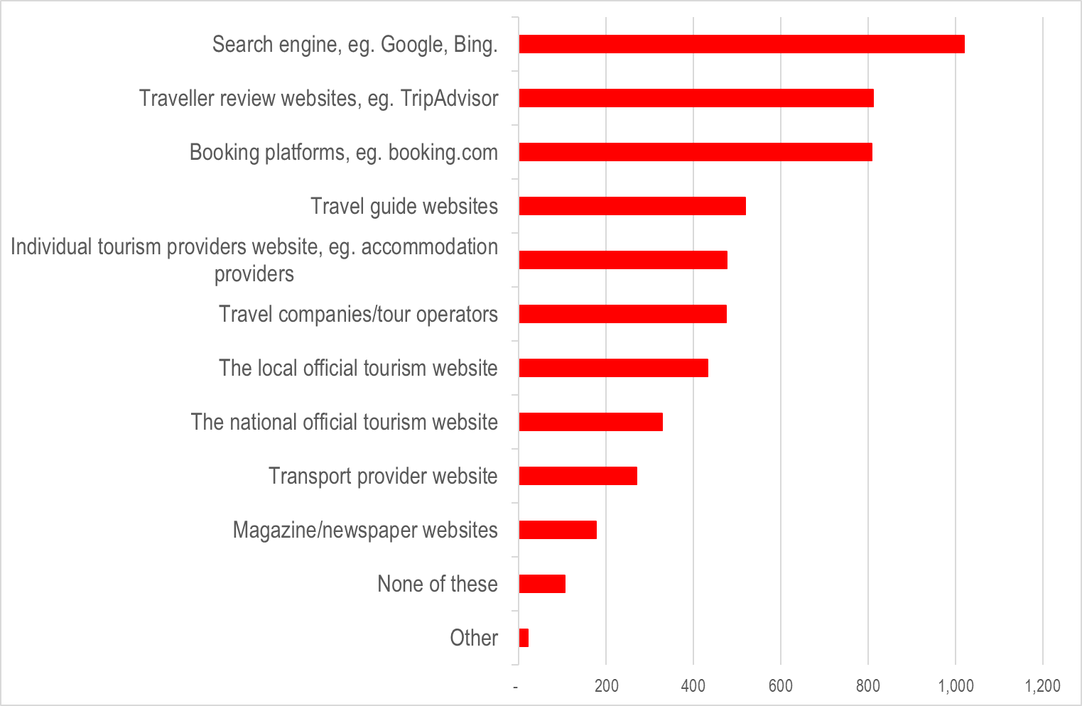
Types of website used when planning a holiday

Slide 19
Types of website – ‘Other please state’

Slide 20
Deciding what to do in the destination

Slide 21
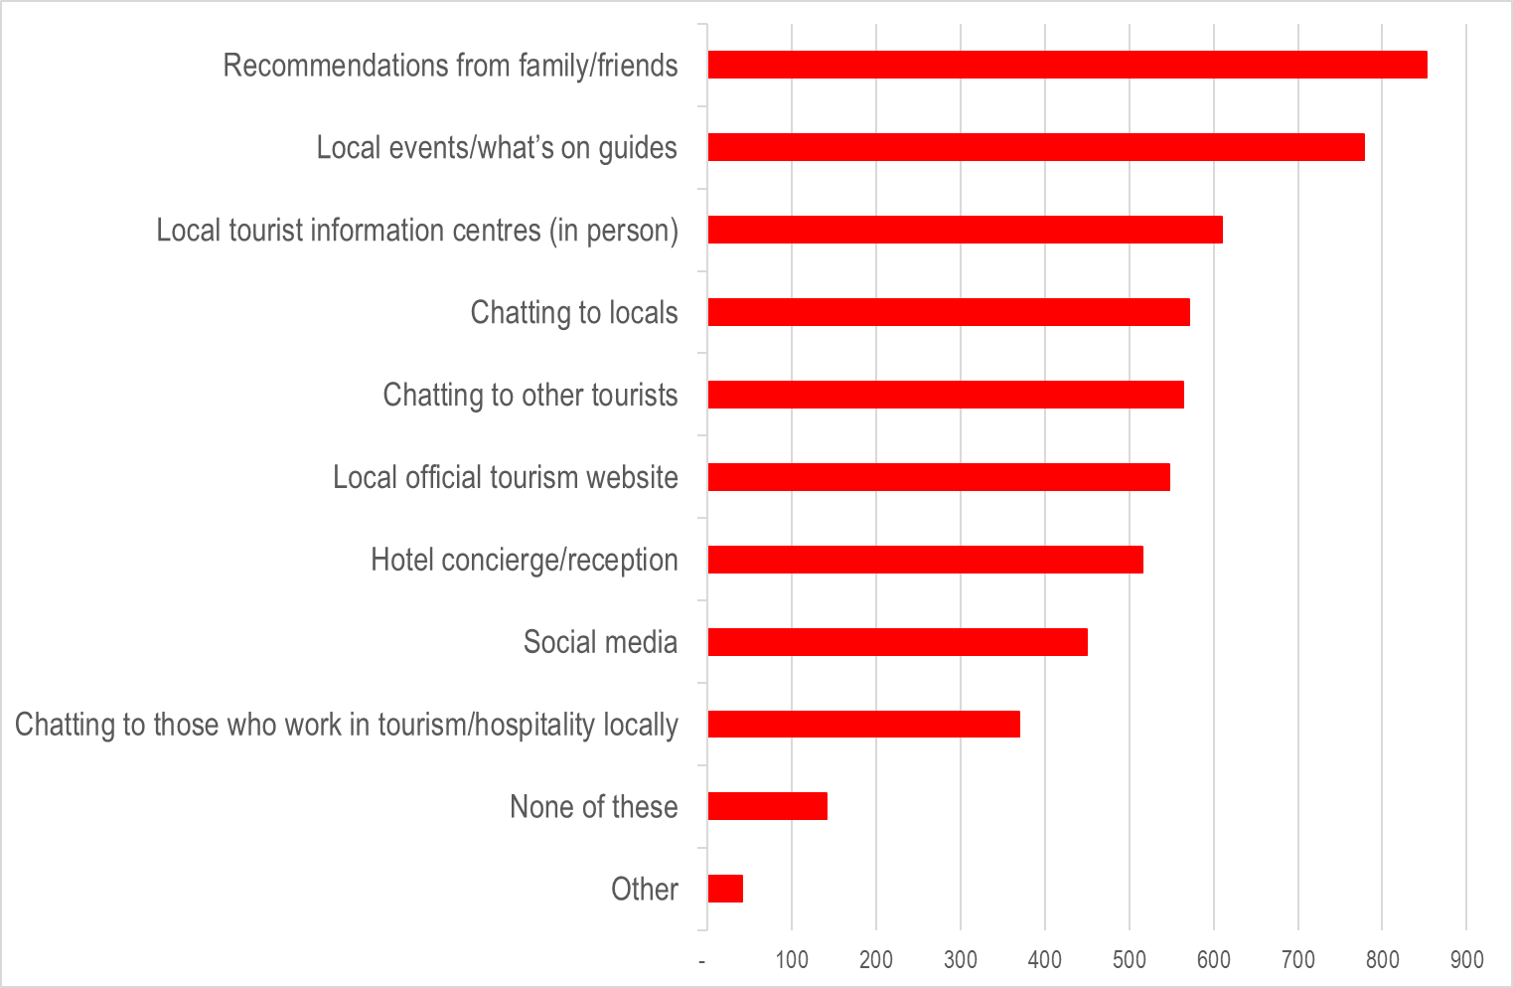
Deciding what to do in the destination

Slide 22
‘Other – please state’

Slide 23
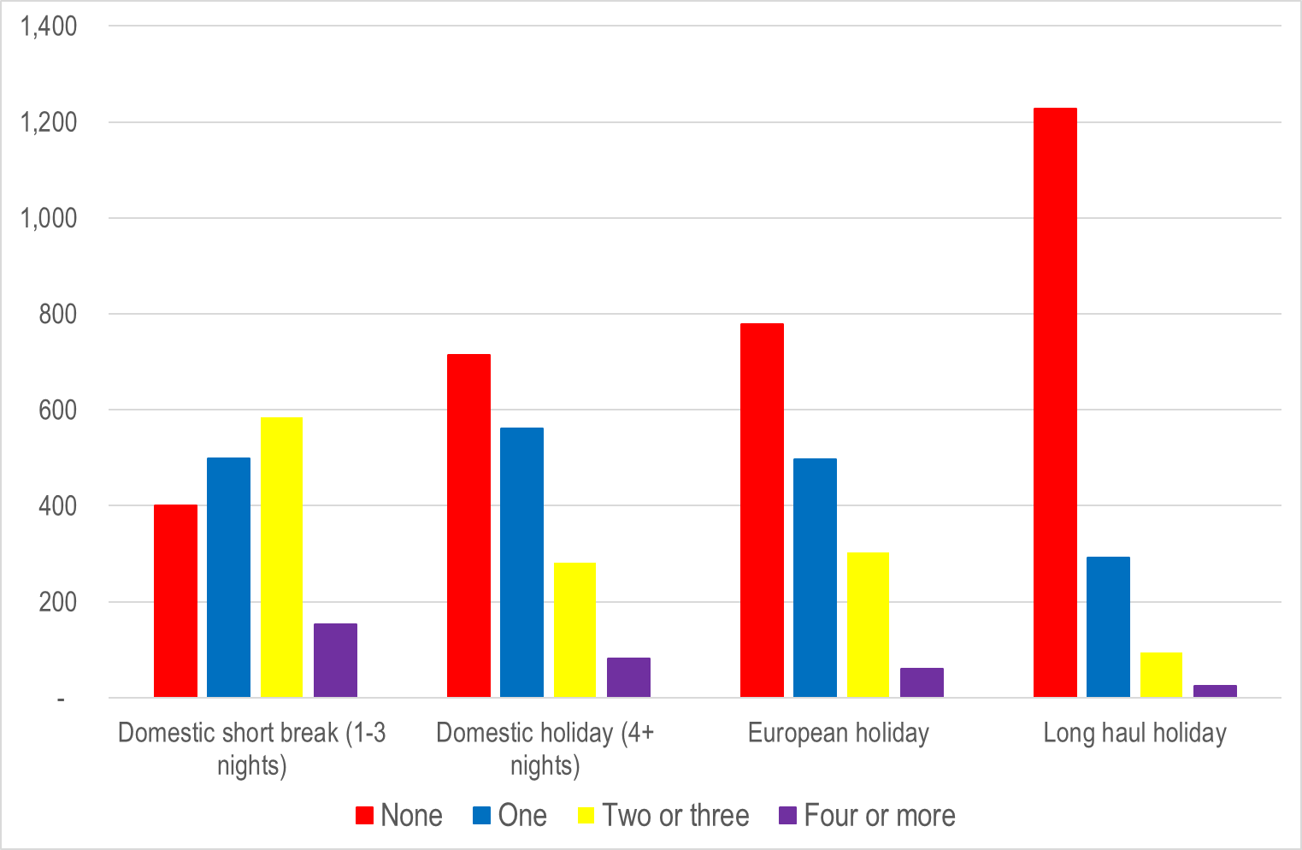
Number of holidays in past year

Slide 24
Agree / disagree statements

Slide 25
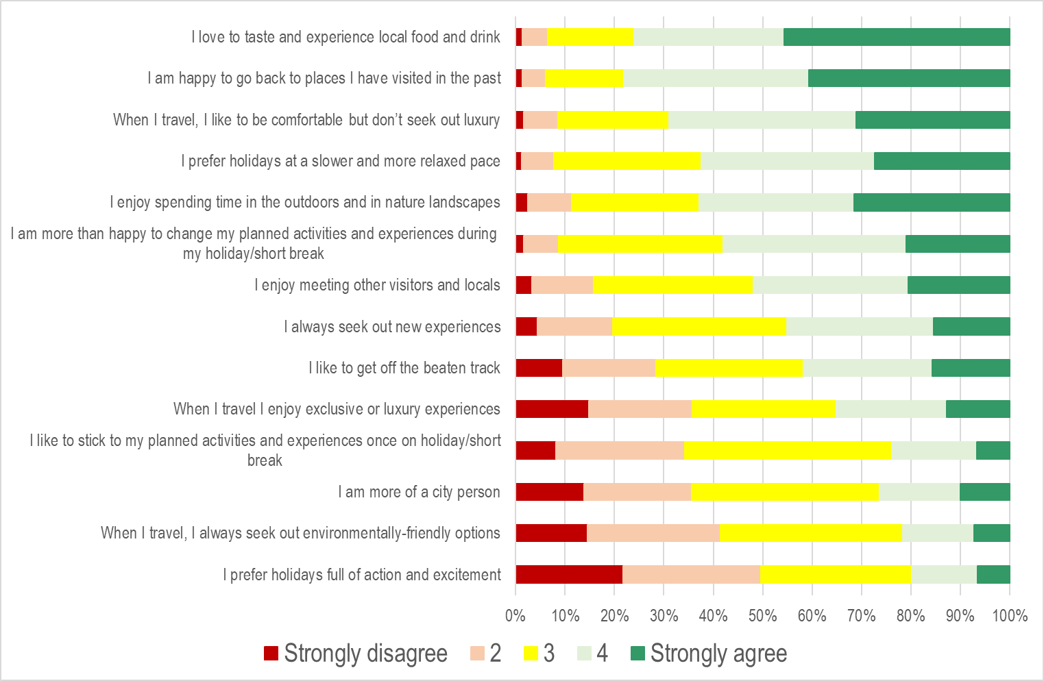
Agree / disagree statements

Slide 26
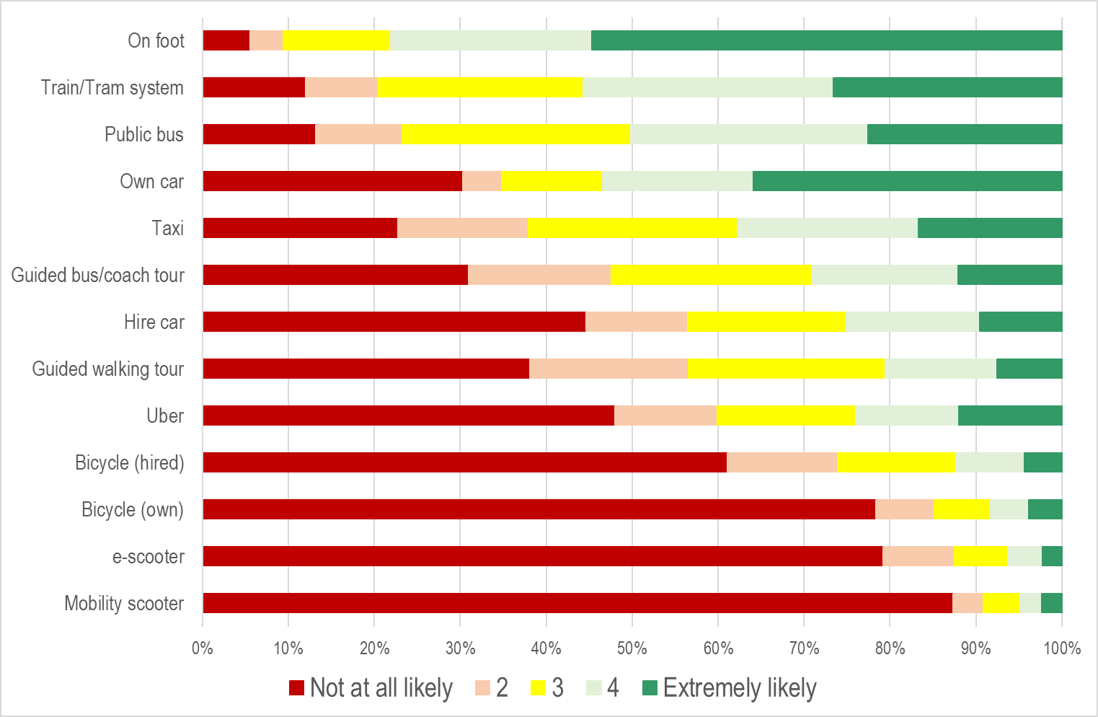
Modes of transport likely to use at destination

Slide 27
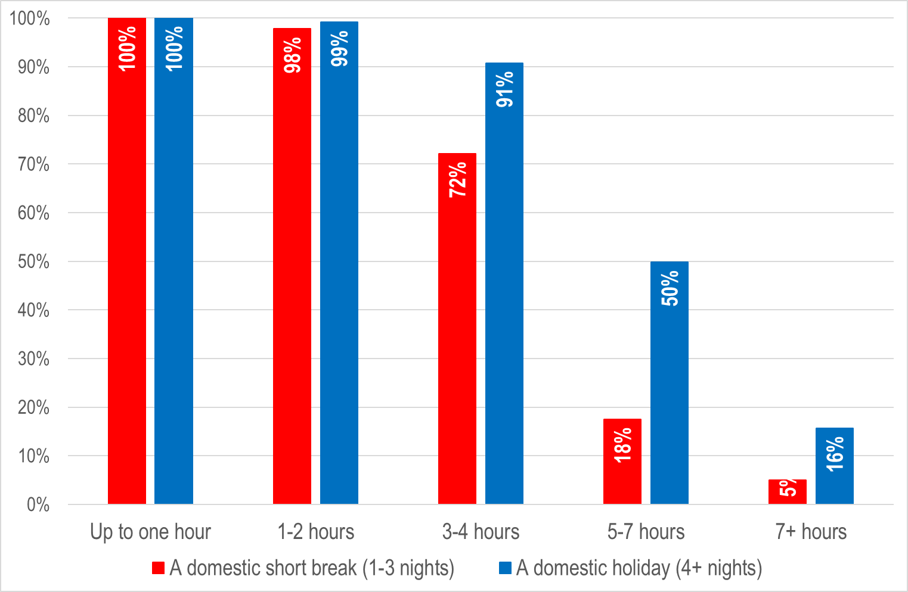
Journey time tolerances

Slide 28
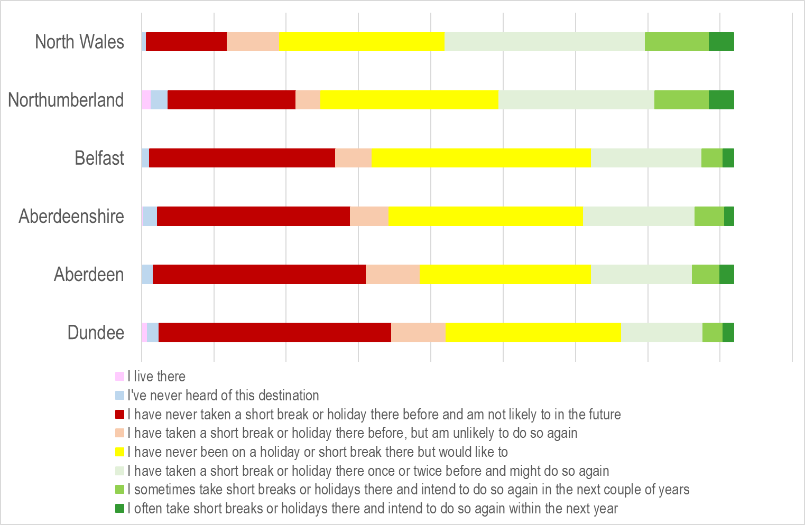
Destination disposition

Slide 29
Destination disposition

Slide 30
Words and phrases
Early in the survey respondents were asked to pick up to 3 words or phrases that would describe their ideal holiday or short-break destination
Later respondents were asked to pick up to 3 words / phrases from the same predefined list that they felt most and least describe Aberdeen and another city OR Aberdeenshire and another rural destination

Slide 31
Destination sets

Slide 32
Words / phrases

Slide 33
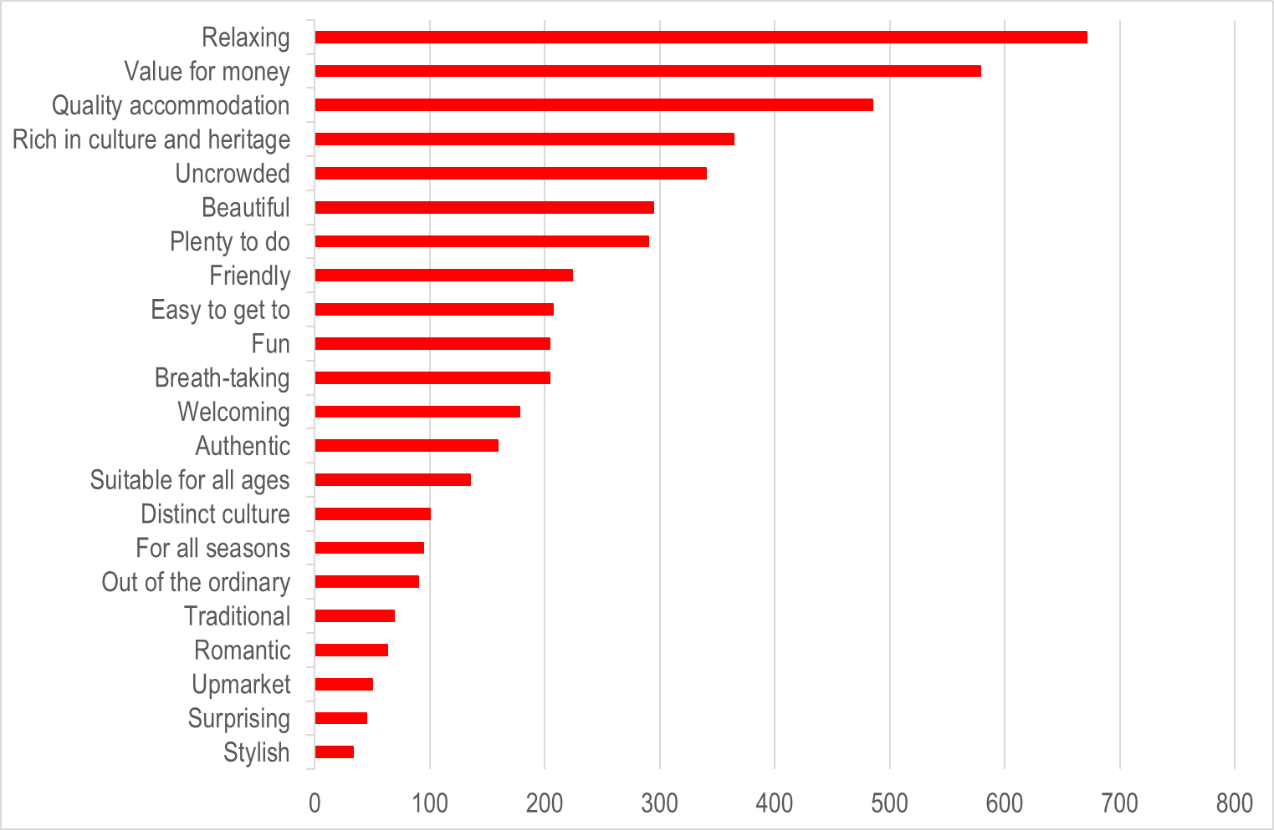
‘Ideal’ holiday or short-break destination

Slide 34
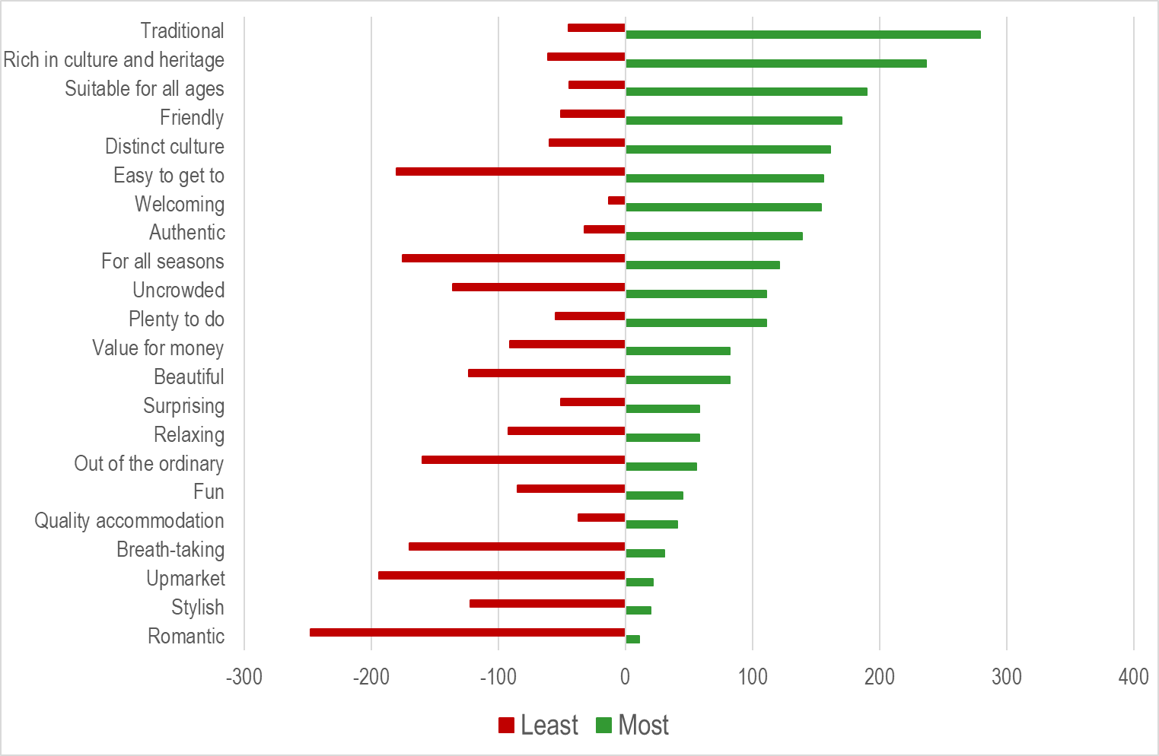
Words / phrases for Aberdeen City

Slide 35
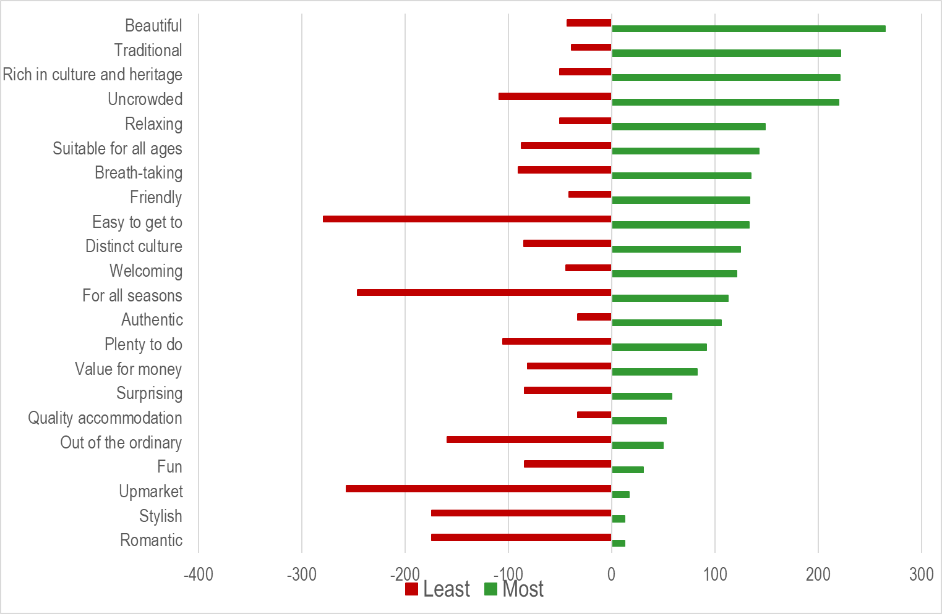
Words / phrases for Aberdeenshire

Slide 36
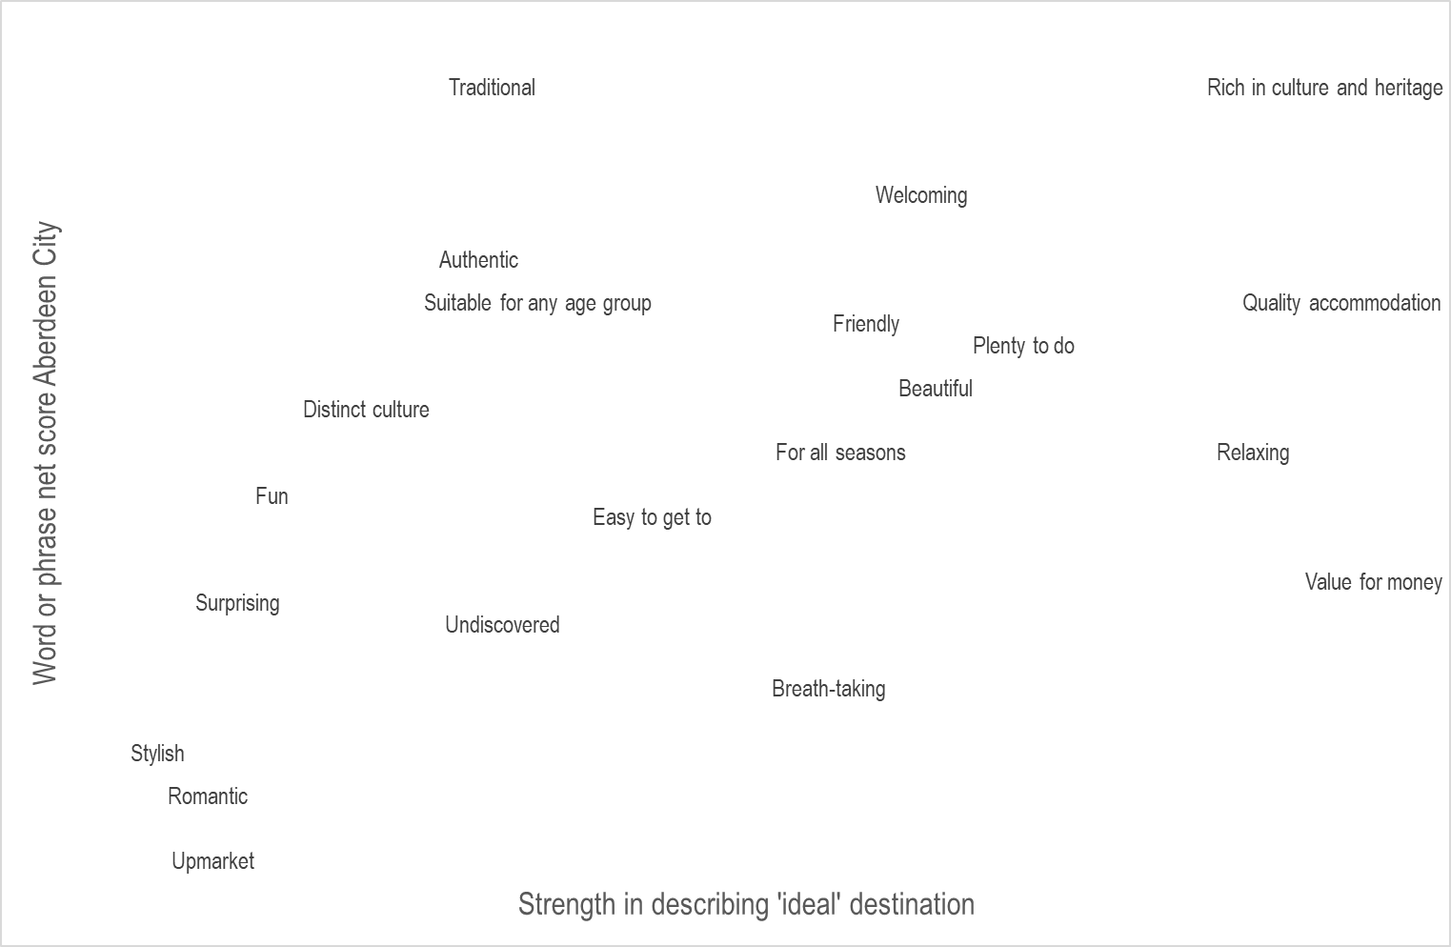
How does the region perform against “ideal”
They don’t want it but think you’ve got it
They want it and think you’ve got it
Ideally words and phrases align with the 45º diagonal
They don’t want it and don’t think you’ve not got it
They want it but don’t think you’ve got it

Slide 37
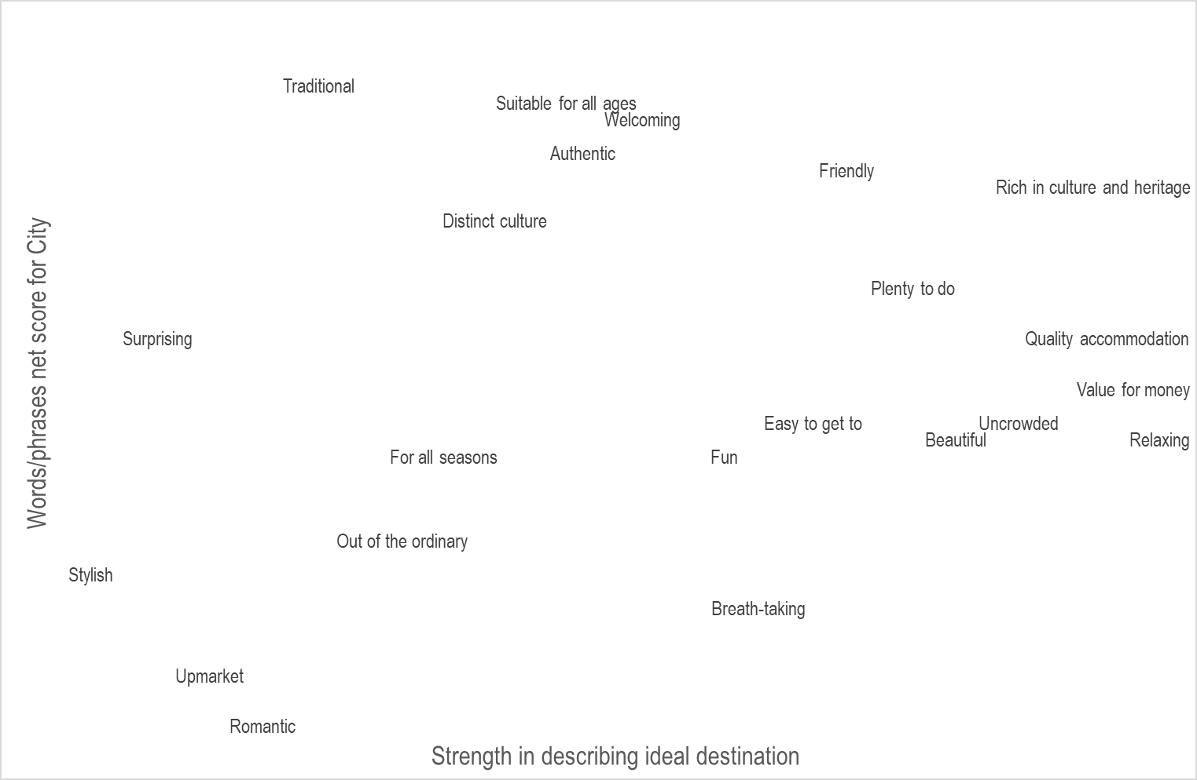
How does the City perform against “ideal”?

Slide 38
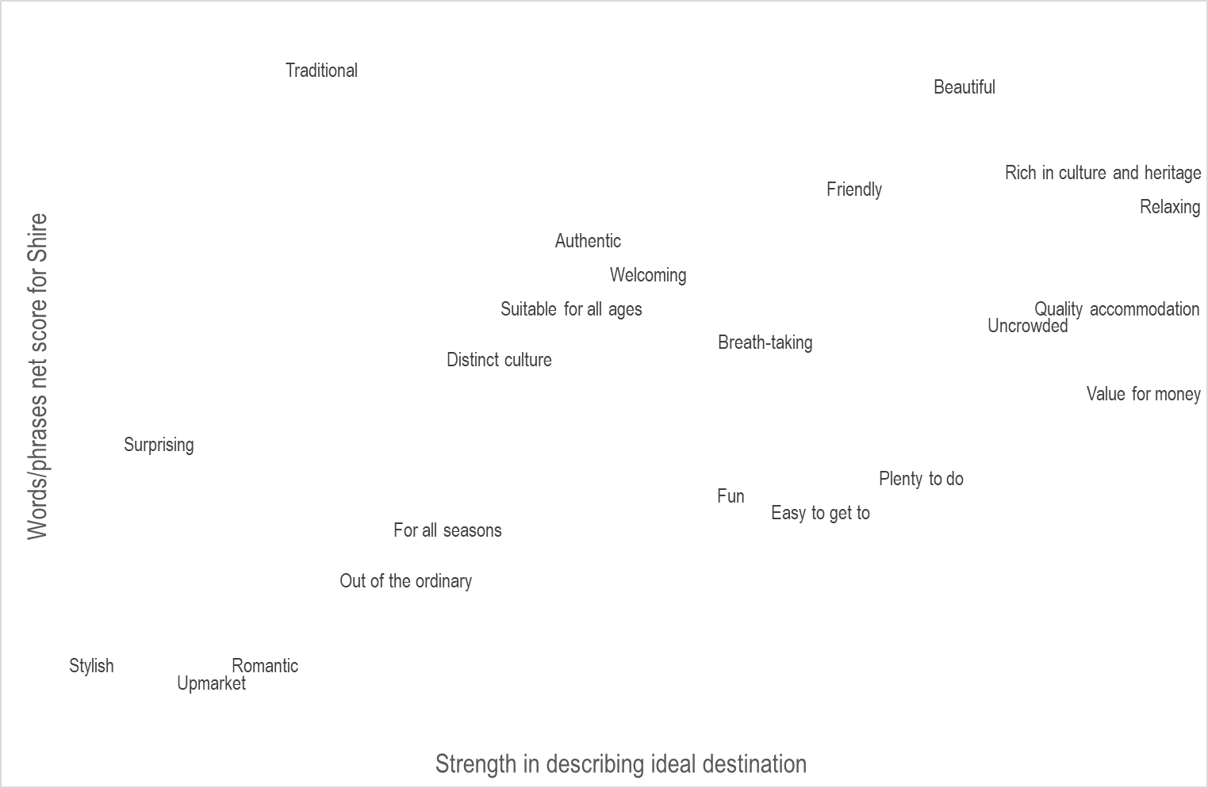
How does the Shire perform against “ideal”?

Slide 39
Competitive strengths/weaknesses

Slide 40
Competitive strengths/weaknesses

Slide 43
Points to ponder (1)
Results largely mirror those from a year ago
The types of holiday respondents tended to favour included city breaks, holidays to enjoy the landscape, to enjoy local food and drink and beach holidays
Sightseeing, relaxing and enjoying local food and drink are popular holiday activities, while only a minority indulge in water-sports, cycling or golf
Talking to friends and family, websites and past personal experience play a key role in influencing destination choice, while only a small minority say they are influenced by ‘influencers or travel bloggers’

Slide 44
Points to ponder (2)
Recommendations from friends and family, local events/what’s on guides and TICs are the most common sources used for deciding what to do once at a destination
76% had taken at least one domestic short-break in the past year, 56% a longer domestic holiday, 53% a European holiday and 25% a long-haul holiday
Most are happy to return to places visited in the past, and tasting local food and drink appeals
Few seek out environmentally friendly holiday options and most say that they are not after holidays that are full of action and excitement

Slide 45
Points to ponder (3)
Exploring on foot is the most common way of getting around once at the destination
Nearly two-in-three are happy to travel up to 4 hours to reach a short-break destination, but only 5% will countenance travelling 7+ hours
36% indicated that they never have, nor will in the future, visit Aberdeen with the equivalent figure for the Shire being 33%
Encouragingly 29% (City) and 33% (Shire) say that while they have not visited in the past they would like to

Slide 46
Points to ponder (4)
An ‘ideal’ holiday destination would meet both emotional and functional needs; being relaxing, offering value for money, quality accommodation and somewhere rich in culture and heritage
The City performs strongly for ‘Traditional’ and ‘Rich in culture and heritage’ while the Shire scores highly for ‘Beautiful’
Many think that ‘Easy to get to’, and ‘For all seasons’ are phrases they least associate with the destination
Although City and Shire perform at least as well as competitors for ‘Traditional’ this is not a key driver
The destination is perceived as offering walks, heritage, golf and the chance to enjoy local food and drink

Slide 47
About the analysis
These slides have been created on behalf of VisitAberdeenshire by Scattered Clouds who undertook the survey analysis in October 2023

